Slide 1

Basic Understanding of cloud solution
Presented by
Amiksha dixit
(2200680110020)
(B. Tech computer science & information technology)
Meerut institute of engineering and technology

Slide 2
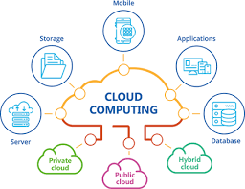
Introduction to cloud solutions
Internet-based computing service
Provide storage, servers, networking and software
Pay-as-you-go model (makes it cost effective)
Accessible anytime, from anywhere

Slide 3
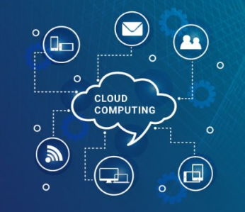
Types of cloud services
IaaS (Infrastructure as a Service) : Basically, virtual servers and storage
PaaS (Platform as a Service) : Tools for developers
SaaS (Software as a Service) : Web-based applications (Example – Gmail, Zoom etc.)

Slide 4
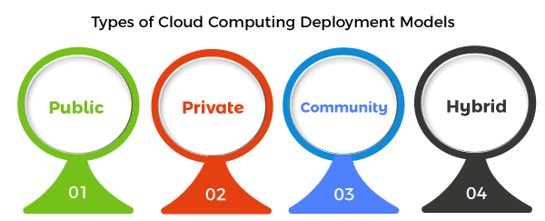
Deployment models of cloud
Public cloud : Shared resources and low cost (AWS, Azure)
Private cloud : Dedicated and secure (Banking, Government)
Hybrid cloud : Private + Public, generally flexible but more complex (Netflix, Healthcare)

Slide 5
Key benefits of cloud
Cost efficiency: Pay only for what you use
Scalability: Easy to scale-up and down
Cloud
Accessibility: Anytime and anywhere access
Security: Advanced data protection

Slide 6

Challenges in cloud adoption
Security Risks : Data breaches, privacy concerns
Downtime : Service outages disrupt work
Cost Management : Risk of overspending
Compliance Issues : Legal & regulatory hurdles
Vendor Lock-in : Limited flexibility with one provider

Slide 7

Future of cloud computing
AI + Cloud : Smarter and automated services
Server-less computing : Focus on applications, not on servers
Edge computing : Faster processing for users
Sustainable cloud : Green, eco-friendly and energy efficient
Cloud-First world : Business shifting fully to cloud
Thank You !!

